Slide 1
Victim rescue system
with Drone
Yamazaki Yuki
Notes:
My research theme is Drone victim rescue system

Slide 2
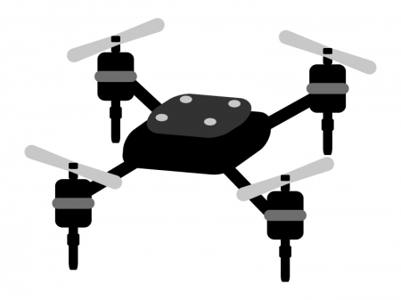




My idea of rescue system
Contact rescue team
HELP!!
Drone
Drone’s Location
Victim
Ground Control Station
Notes:
Next, the rescue system.
This drone is supposed to search for the victims' voices and identify the place.
When Drone detects the victim's voice, it sends GPS position information to GCS. Then rescue the victim by reporting the information to the rescue team.
In this system, I would like to work on the development of the part / that detects the voice of the victim / at this workshop.

Slide 3
Initial plan
1. Use Python language
2. Restrict the recognized word only “Help”

Slide 4
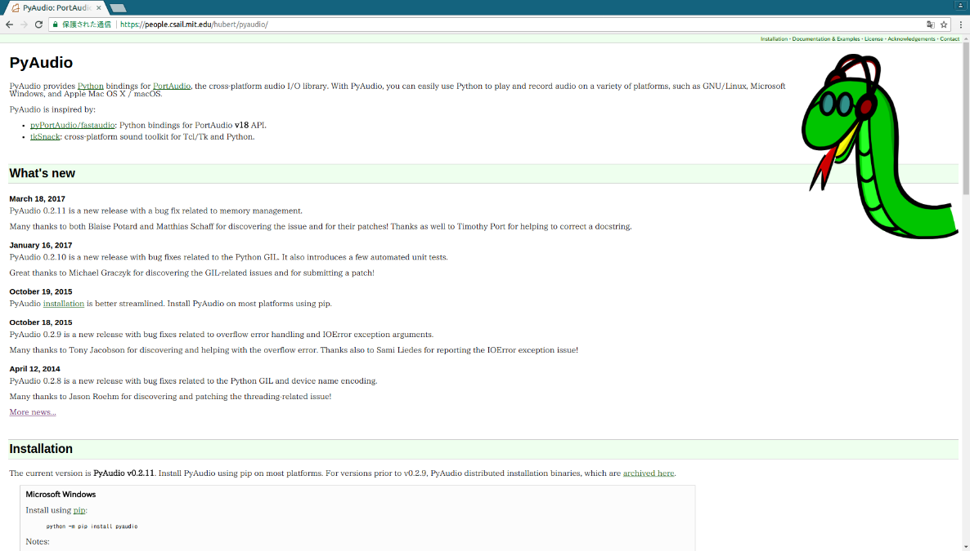
Package used
Mainly : PyAudio, PyLab
・PyAudio
With PyAudio, we can easily use Python to play and record audio on a variety of platforms
・PyLab
It have functions similar to Mat-lab

Slide 5
Step1 – Recording program
Here I will show you My program which records sound and plot
it in a graph.
The resulting graph is the input to next step.

Slide 6
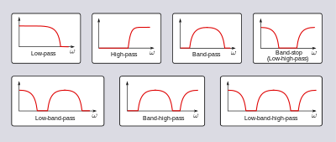
Step2 – White noise filtering
・What is filtering?
Filtering is a device or a process that removes unwanted components or features from a signal.

Slide 7
Future tasks
1. We have to study hardly especially about digital signal processing
2. To Recognize word “Help!” we have to study about NLP and ANN.
3. We will continue to develop jointly to achieve the initial plan

